Slide 1

Credit Risk Prediction Model
Presented by
Shreeja S Maiya
AI ML Intern

Slide 2

Problem Statement
Banks and financial institutions face loan default risk
Manual credit evaluation is time-consuming and subjective.
Objective: Build an AI model to predict credit risk efficiently.

Slide 3
Data & Challenges
Dataset: Kaggle Credit Risk Dataset.Loan applications + synthetic data (CTGAN).
Challenges:Class imbalance (few defaults vs many non-defaults) and Feature complexity and correlations
Solution: Synthetic data generation to balance the dataset.

Slide 4
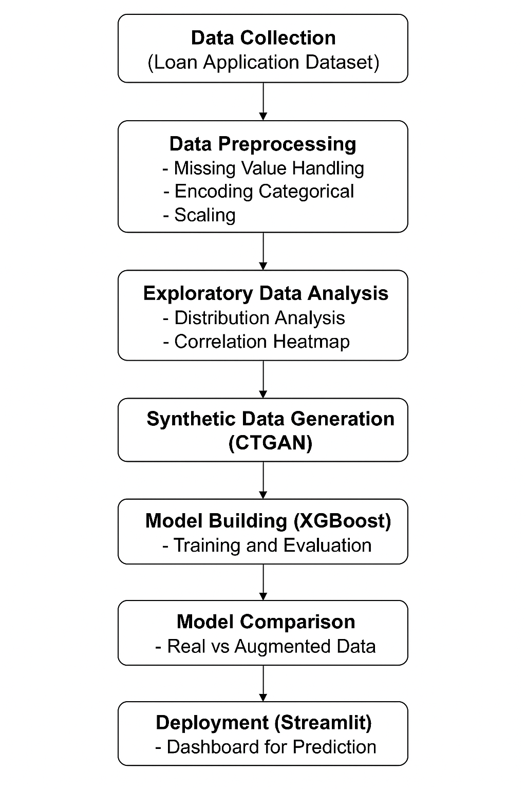
Methodology and Workflow Diagram
The overall methodology followed in this project combines data collection , data analysis, data balancing, model building, and deployment. The workflow is designed to systematically move from raw data understanding to a fully functional predictive dashboard.

Slide 5
Exploratory Data Analysis
The EDA revealed that
The dataset is imbalanced.
loan_int_rate and loan_percent_income are strong indicators of credit risk.
High loan amount and low income increase default probability
Relationships are non-linear, supporting the choice of XGBoost

Slide 6
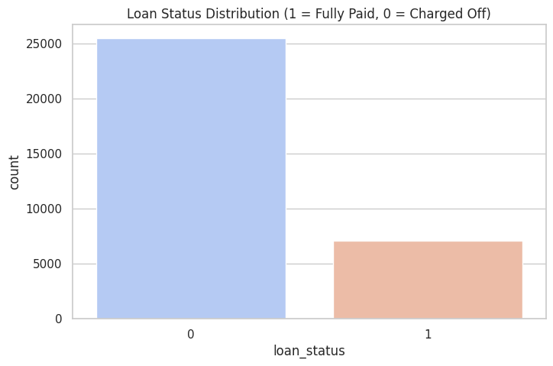
Loan Distribution Data

Slide 7
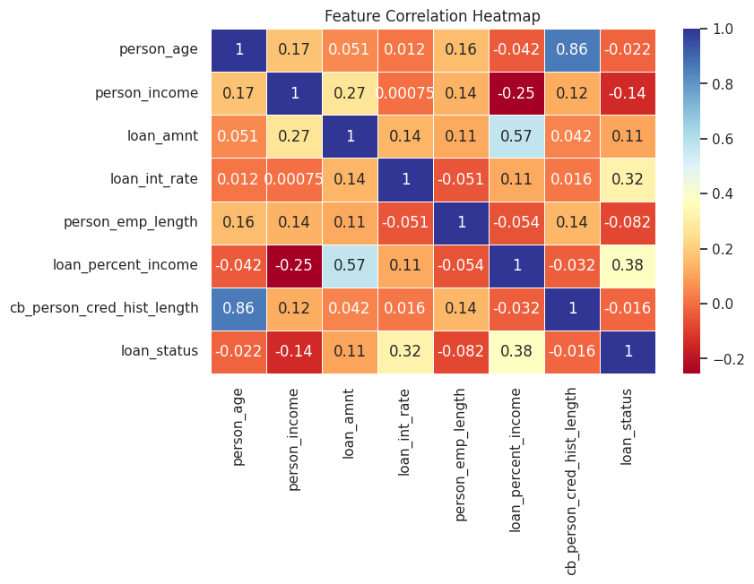
Feature correlation heatmap: loan_percent_income and loan_int_rate have the strongest positive linear correlation with loan_status (default). Higher values in these features mean higher default risk.

Slide 8
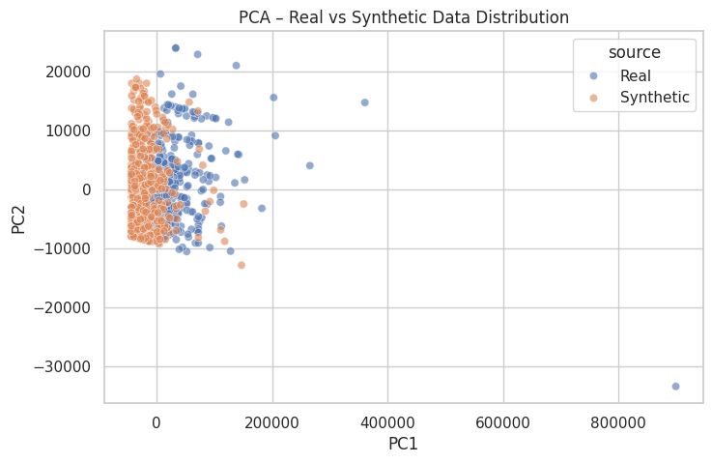
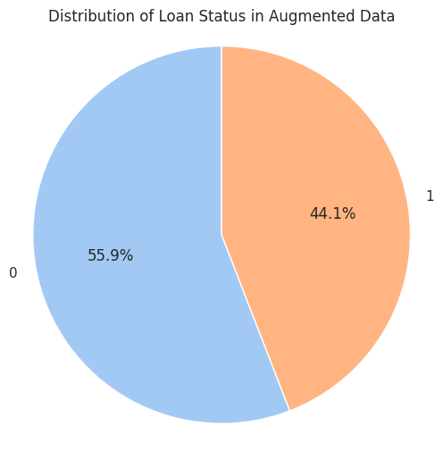
Model Development
Algorithm: XGBoost (best performance)
Pipeline: Data preprocessing → Feature selection → Model training → Evaluation
Metrics: AUC: 0.98, Recall improvement: +17% over baseline

Slide 9
Workflow of deployment
Below is the step-by-step workflow of deployment:
Model Export – Save the trained model with pickle.
App Creation – Write app.py using Streamlit for the frontend interface.
Integration – Load the model and handle user inputs for prediction.
Testing – Validate predictions with test inputs.
Hosting – Locally via streamlit run app.py

Slide 10
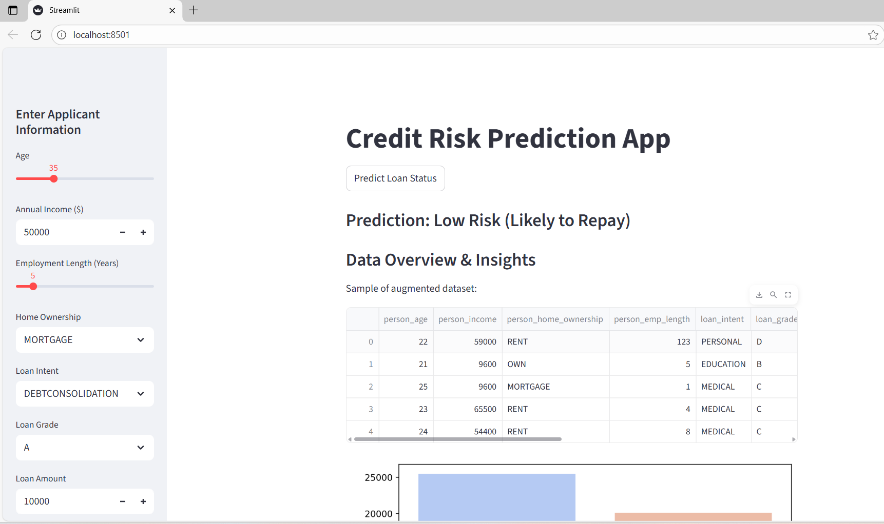
Deployment
Streamlit App: Interactive web tool for real-time loan predictions
Features: User-friendly interface, instant risk score, visual insights

Slide 11
Conclusion
Developed an end-to-end credit risk prediction system
Addressed class imbalance and improved predictive accuracy
Business impact: Faster, data-driven, reliable loan decisions

Slide 12

Future Work
Integrate real-time financial data
Explore deep learning & ensemble models
Improve interpretability with SHAP/LIME
Cloud-based deployment with API integration

Slide 13
Thank you!

